Slide 1

A MINI PROJECT
ON
TO CREATE A WEB PAGE FOR MOVIE TICKET TRANSFER (ISM)
Department - COMPUTER SCIENCE ENGINEERING
Done by :-
B Sharath Chandra Reddy (19E41A05K4)
CH karthik (19E41A05G2)
Y Akshith (19E41A05H9)
AC Adarsh (19E41A05M0)

Slide 2
CONTENTS
ABSTRACT
INTRODUCTION
PROJECT’S OBJECTIVE
SOFTWARE AND HARDWARE REQUIRMENTS
DESIGN OF UML DIAGRAMS
DATA FLOW DIAGRAM
IMPLEMENTATION OF MODULES
ADVANTAGES AND DISADVANTAGES
CONCLUSION
FUTURE SCOPE
REFERENCE

Slide 3
Abstract
Movie Ticket Trensfer (ISM), it is the ideology about the movie tickets selling in the website, which are already purchased from the Bookmyshow.
The main intension of this project is not to waste money as well as tickets.
And those tickets will be available in the website which is developed free of cost and always available for users(user friendly).

Slide 4
INTRODUCTION
The tickets which are booked in the Bookmyshow by any person, and if he is not able to attend the show due to any problem and if he wants to cancel the show tickets, then our website will always available at that situations at free of cost.
Here the owner who wanted to sell tickets, he may sell on our platform to customers who are looking for tickets on our website.
In our webpage only movie tickets are available.
The main thing is that we’re not going to sell tickets by increasing their original price. We keep tickets available at discounted prices. Here on our platform tickets are available in (25%) Twenty five percent less than the original price.

Slide 5



PROJECT’S OBJECTIVE:-
The main objective of this project is to sell the tickets in the website which is user friendly environment of users and owners.
ISM (Website)
movie ticketsz
SELLER
Buyer

Slide 6
SOFTWARE AND HARDWARE REQUIRMENTS
HARDWARE REQUIREMENTS:
System : Intel i3 or Above
Hard Disk : 100 GB or Above
Internet : 2Mbps or Above
Ram : 4GB or Above
SOFTWARE REQUIREMENTS:
Operating system : Windows 10
programming Language : Python
Front-End : Html ,CSS
Designing : Html, Css, java script
Data Base : SQLite3
Execution tool : Pycharm

Slide 7
DESIGN OF UML DIAGRAMS
USE CASE DIAGRAM

Slide 8
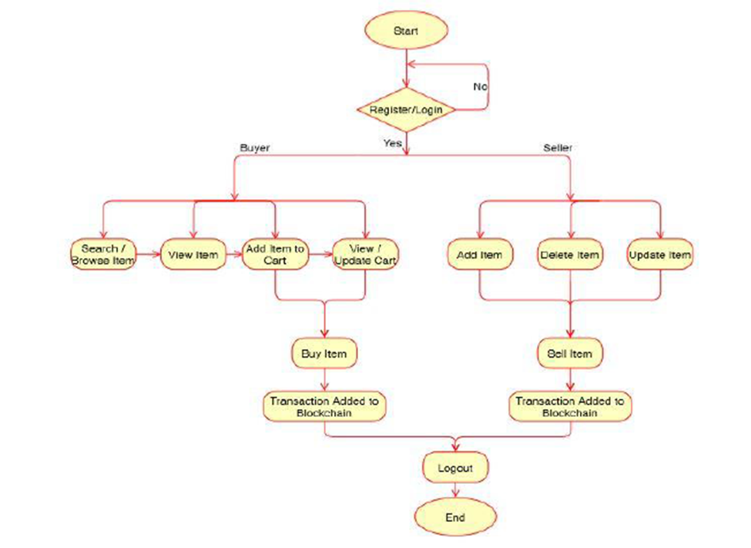
DATA FLOW DIAGRAM:

Slide 9
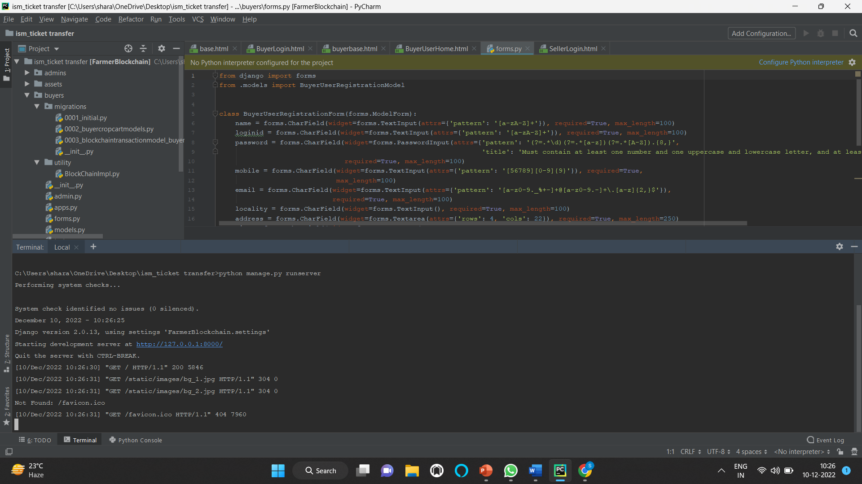
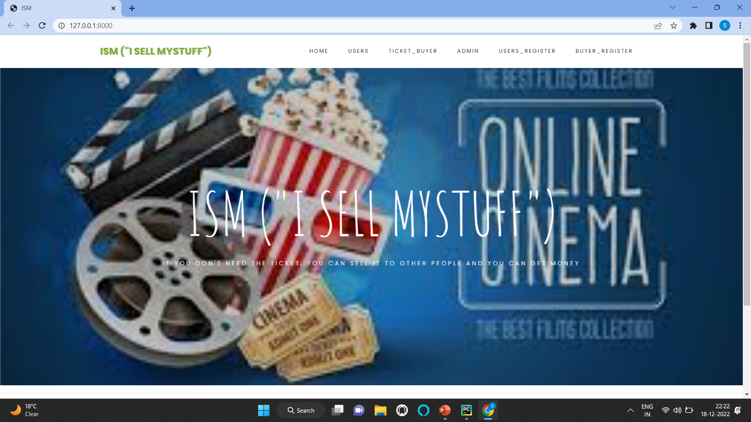
IMPLEMENTATION OF MODULES
Using pycharm
Home page

Slide 10
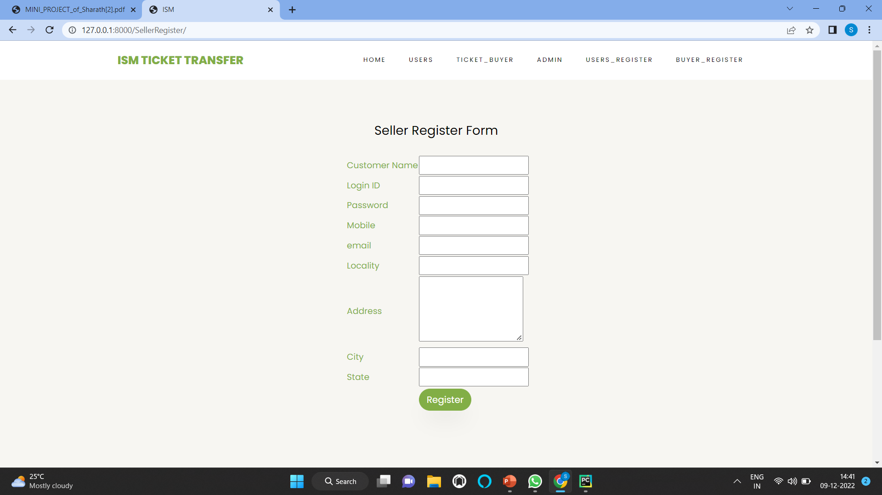
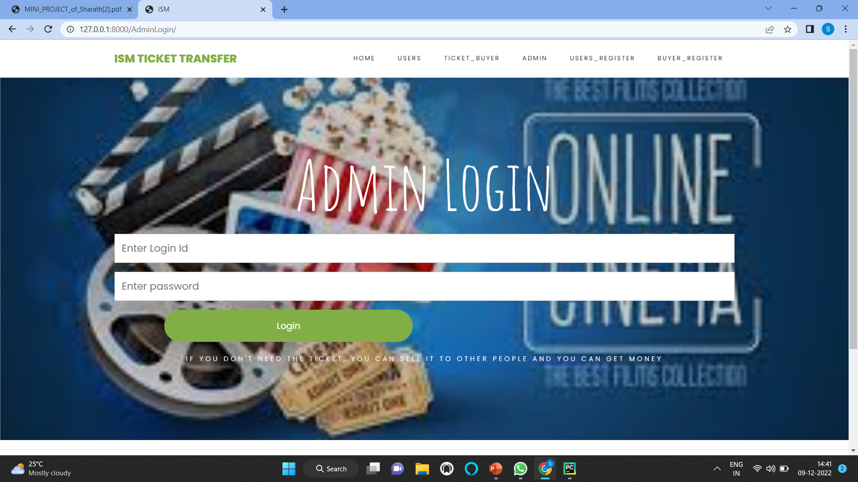

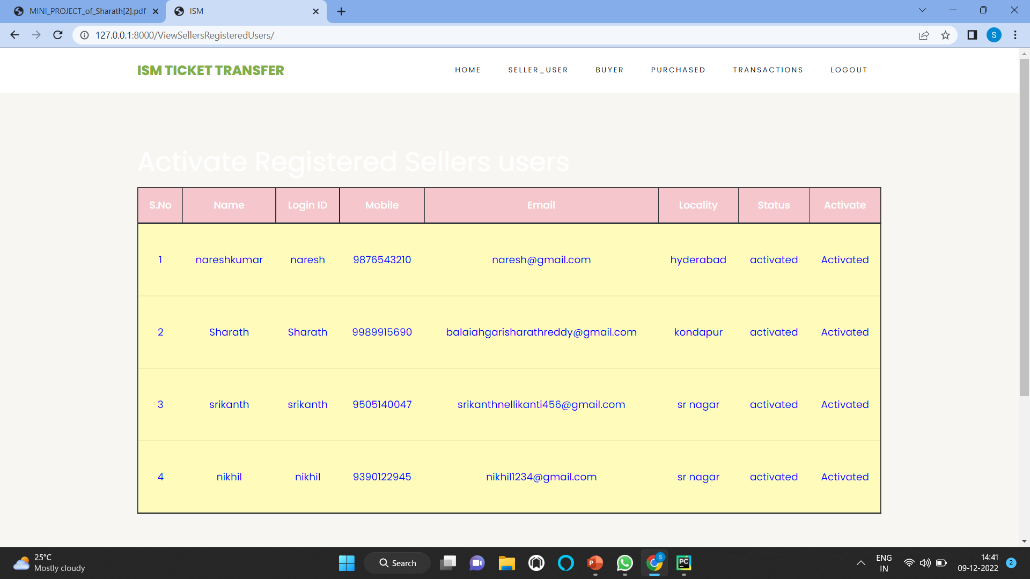
Seller
Admin

Slide 11
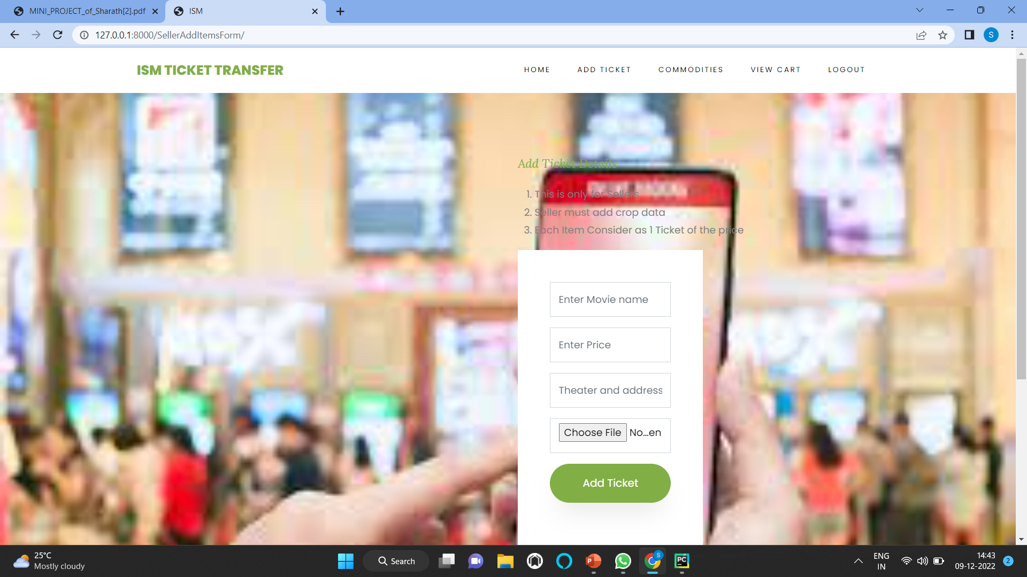
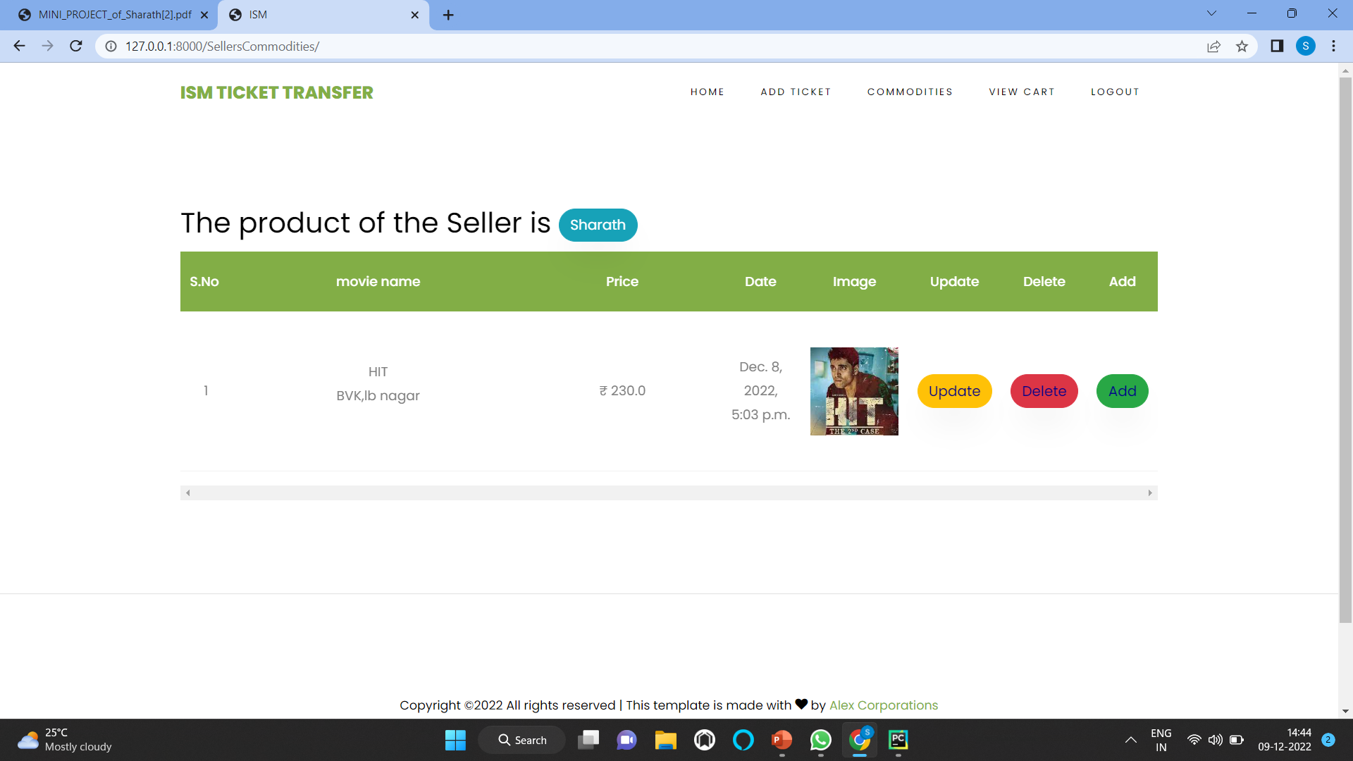
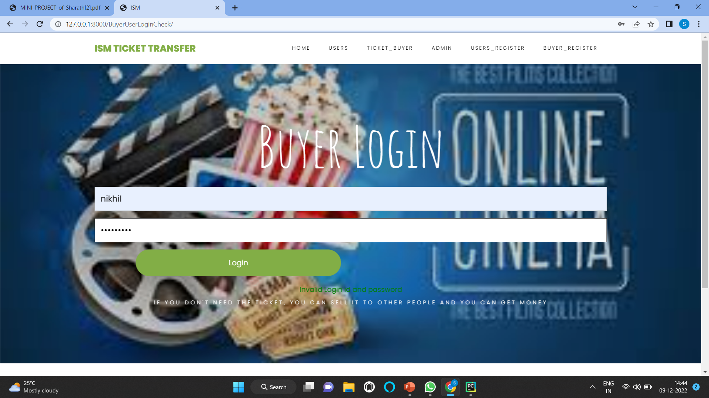
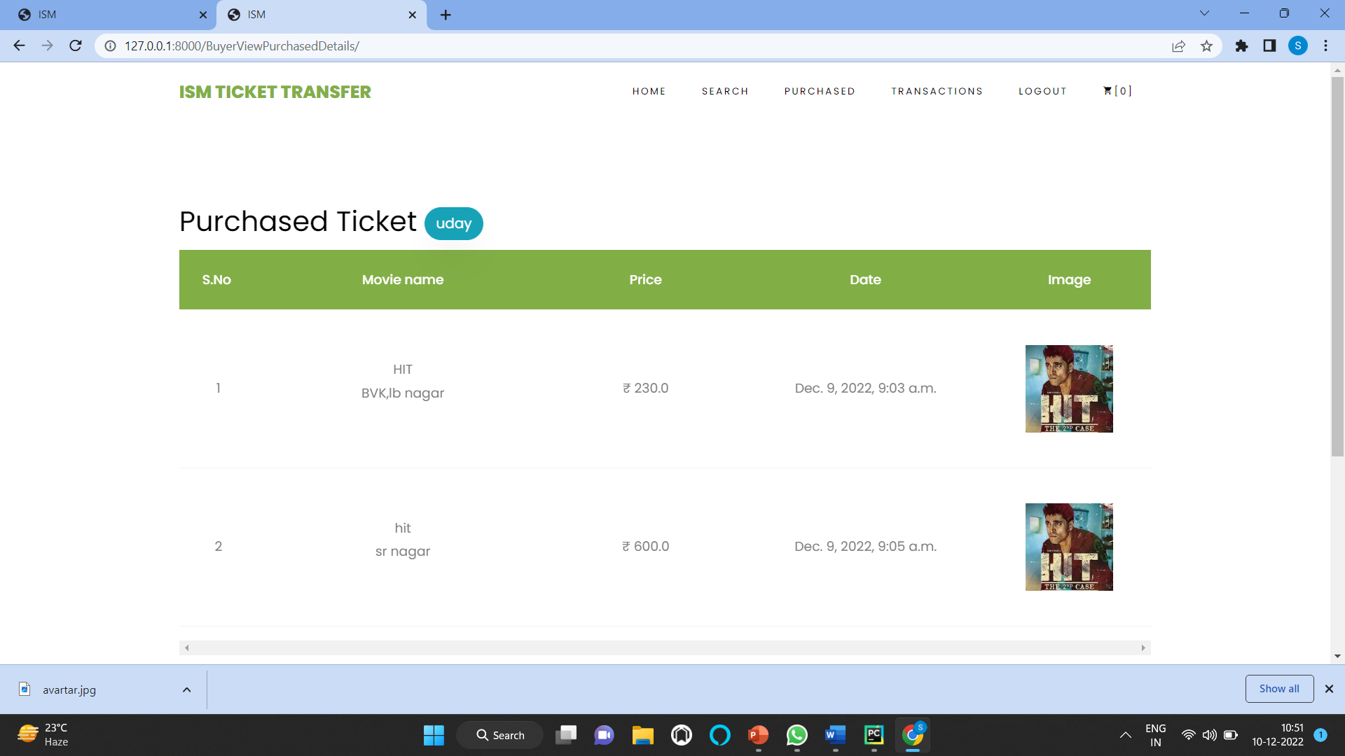
Add Ticket
Buyer

Slide 12
ADVANTAGES AND DISADVANTAGES
ADVANTAGES :
Extra unplanned tickets resell in our website
Disadvantages :
It is only Developed for movie tickets

Slide 13
CONCLUSION
In this website movie tickets are Purchased online with some discount of 25% other than Original price of movie ticket.
Then wastage of money will be reduced.

Slide 14
FUTURE SCOPE
In future we extend to add certain extra features like bus tickets, train Tickets, flight Tickets and Event tickets also.

Slide 15
REFERENCE
www.google.com
www.wikipedia.com
www.studymafia.org
Word press tutorials from learn Wordpress.com.
W3 Schools CSS Tutorial Reference.
W3 School HTML Tutorial Reference.

Slide 16


